Slide 1
WEBMONK (COURSE DAY - 7)
Topics covered:
* what is node.js
* npm
* synchronous / async, blocking/non-blocking, event loop, timers
* packages - fs, http, path

Slide 2
WHAT IS NODE.JS?

Slide 3
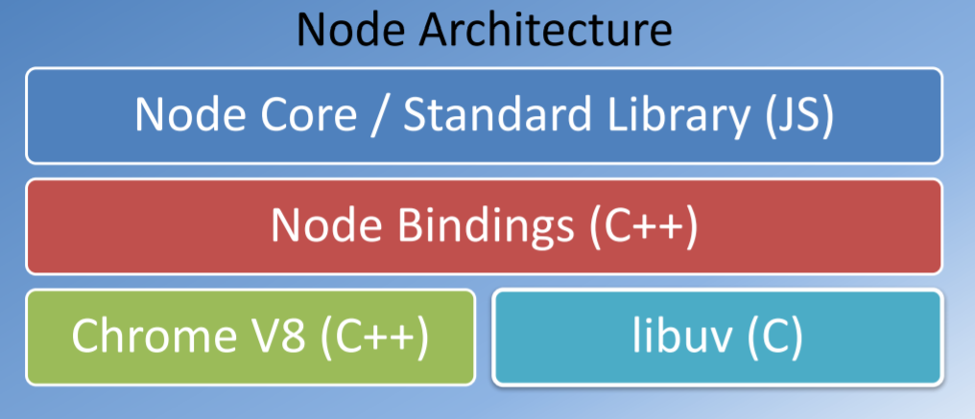
INTRODUCTION
* JavaScript runtime built on Chrome V8 JavaScript Engine.
* uses an event-driven, non-blocking(asynchronous) I/O model.
* makes it lightweight and efficient

Slide 4
NODE.JS USE CASE ?

Slide 5
USE-CASE
* utilities written in JavaScript for web development:
* Bower, Grunt, Gulp, Yeoman etc.
* server-side Development:
* web server, business logic, database access
* utilities for several purposes:
* web-scraper scripts
* data parsing scripts, etc.

Slide 6
NODE PACKAGE MANAGER

Slide 7
NODE PACKAGE MANAGER
* node package manager (NPM): manages ecosystem of node modules/packages
* a package contains:
* JS files
* package.json (manifest)

Slide 8
REVISITING PREVIOUS CONCEPT SYNCHRONOUS/ASYNC, BLOCKING/NON-BLOCKING

Slide 9
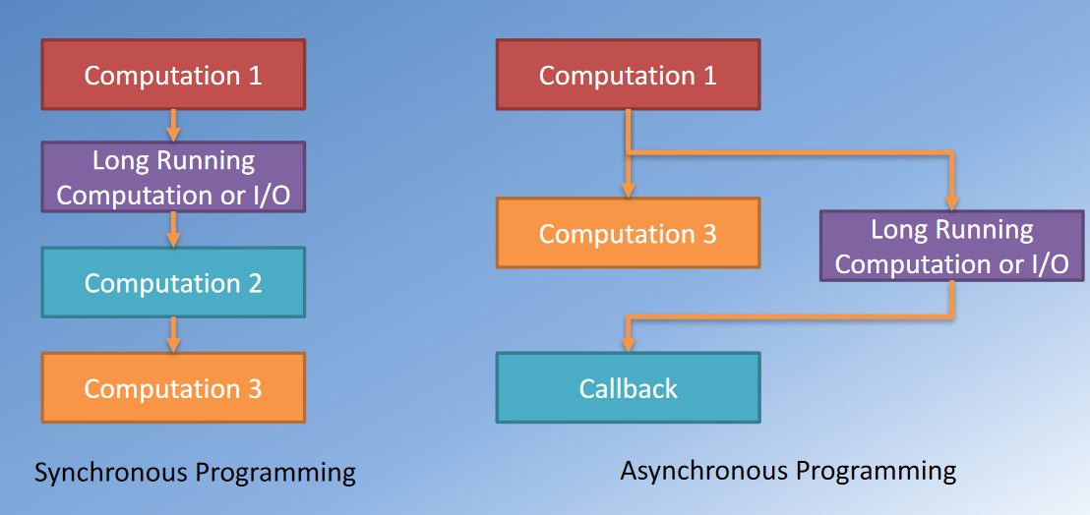
SYNCHRONOUS & ASYNCHRONOUS

Slide 10
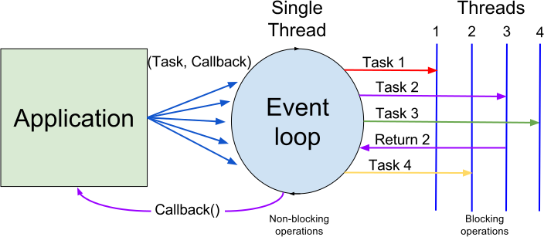
EVENT LOOP EXPLAINED

Slide 11
NODE MODULES

Slide 12
NODE MODULES
* each file in node is its own module.
* the module variable gives access to the current module definition in a file.
* the module.exports variable determines the export from the current module.
* the require function is used to import a module.
* eg: file-based modules, core modules (path, fs, os, util), external node modules (3rd party modules, installed using npm)

Slide 13
HTTP
* core networking module supporting a high-performance foundation for a HTTP stack
* using the module: const http = require('http');
* creating a server: const server = http.createServer(function(req, res){ . . . });
* starting the server: server.listen(port, . . . );
* incoming request message information available through the first parameter “req”
* response message is constructed on the second parameter “res”

Slide 14
PATH
* the path module provides utilities for working with file and directory paths.
* it can be accessed using: const path = require('path');
* the path.isAbsolute() method determines if path is an absolute path.
* the path.join() method joins all given path segments together using the platform-specific separator as a delimiter, then normalizes the resulting path.
* the path.resolve() method resolves a sequence of paths or path segments into an absolute path.

Slide 15
FS
* the fs module enables interacting with the file system in a way modeled on standard POSIX functions.
* it can be accessed using: const fs = require('fs/promises'); or const fs = require('fs').promises;
* the fs.readFile() method asynchronously reads the entire contents of a file.
* the fs.writeFile() method asynchronously writes data to the file, replacing the file if it already exists. data can be a string or a buffer.
* the fs.unlink() method asynchronously removes a file or symbolic link.

